Slide 1
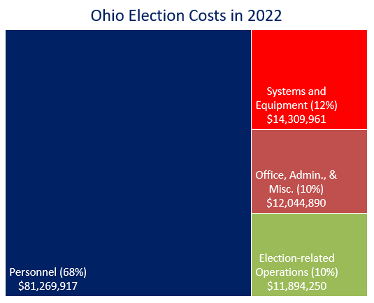
Ohio elections cost $119.5 million in 2022
Nearly 6.5 million votes were cast in the primary, general, and special elections.
Costs for the three elections in 2022 exceeded $119.5 million.
Personnel costs of $81.3 million accounted for 68% of the total.
Systems & Equipment: $14.3 million:
  Voting & Ballots: $8.5 million
  Voter Registration: $3.0 million
  Electronic Pollbooks: $2.8 million
Source: Ohio Secretary of State

